Slide 1







The Times They are A-Changing P1
see outro p2 G\
two pages
Bob Dylan
In 3/4 waltz time
G Em C G
Come gather 'round people wher- ever you roam G Am C D
And ad- mit that the waters ar- ound you have grown,
G Em C G
And ac- cept it that soon you'll be drenched to the bone, G Am D
If your time to you is worth saving,
D7 Gmaj7 D
Then you'd better start swimming or you'll sink like a stone, G C D G
For the times they are a- chang- ing!
G Em C G
Come writers and critics who prophe- size with your pen, G Am C D
And keep your eyes wide, the chance won't come a- gain.
G Em C G
And don't speak too soon, for the wheel's still in spin, G Am D
And there's no telling who that it's naming.
D7 Gmaj7 D
For the loser now will be later to win, G C D G
For the times they are a- chang- ing!
G Em C G
Come senators, congressmen, please heed the call, G Am C D
Don't stand in the doorway, don't block up the hall.
G Em C G
For he that gets hurt will be he who has stalled,
G Am
D
raging.
Gmaj7 D
There's a battle out- side and it's D7
It'll soon shake your windows and rattle your walls, G C D G
For the times they are a- chang- ing!
G Em C G
Come mothers and fathers, through- out the land, G Am C D
And don't criti- cize what you can't under- stand.

Slide 2
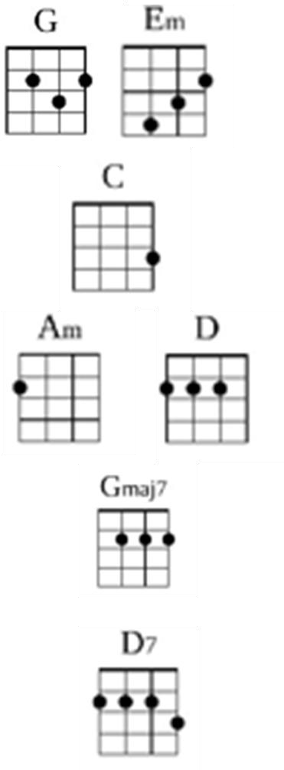
Times They Are A Changing P2
G Em C G
Your sons and your daughters are be- yond your com- mand,
G Am D
Your old road is rapidly aging.
D7 Gmaj7 D
Please get out of the new one if you can't lend your hand, G C D G
For the times they are a- chang- ing!
G Em C G
The line it is drawn, the curse it is cast, G Am C D
The slow one now will later be fast.
G Em C G
As the present now will later be past, G Am D
The order is rapidly fading.
D7 Gmaj7 D
And the first one now will later be last, G C D G\
For the times they are a- chang ing!

